Slide 1

USAT Project Podium Metabolic Testing and Data Analysis Update

Slide 2
Table of Contents
Pg. 3
Project Podium Overview
Pg. 7
Case Study

Slide 3
Project Podium Overview
Strength | Description
Daily Training Environment | Immersive, year-round environment integrating swim, bike, and run sessions with strength, recovery, and tactical skills work. Small, focused athlete group allows for individualized programming and daily coach–athlete interaction. Emphasis on fostering a competitive yet collaborative training culture that prepares athletes for the demands of the World Triathlon circuit.
Supreme Supporting Partners | Backed by world-class equipment, apparel, and nutrition sponsors, ensuring athletes have the same tools as Olympic medal contenders. Access to cutting-edge sport science through USOPC, university partners, and technology providers for performance testing, biomechanics, and data analysis. Integrated support team including physiotherapists, nutritionists, sport psychologists, and bike mechanics. Partnerships that offer mentorship, networking, gear, and professional development opportunities.
Scholarships and Support | Partnership with Arizona State University provides tuition assistance, enabling athletes to pursue degrees while training and competing. Academic advising and flexible class scheduling tailored to elite race calendars. Life skills and career development workshops to prepare athletes for post-sport careers. Proven track record of producing graduates who excel both in sport and in professional pathways.
Facilities and Resources | Access to world-class training venues in Tempe, AZ, and Park City, UT: Elite Pools, private open water swimming areas, indoor/outdoor tracks, dedicated cycling routes, and altitude training opportunities. On-site recovery and rehabilitation facilities, including ice baths, compression therapy, and sports massage. High-tech performance lab for physiological testing, lactate analysis, and power/HR monitoring. Year-round training in an optimal climate that supports consistent outdoor swimming, cycling, and running.

Slide 4



Competition Overview
Project Podium athletes benefit from unique competitive opportunities spanning domestic, regional, and international levels, enabling them to gain experience, earn ranking points, and develop toward the world stage.
Domestic and Regional Competition
World Triathlon Hosted Events
Other Events
USAT National Championships – Project Podium athletes have excelled at the junior national level, winning the last 5 USA National Championships
Development Pipeline – Provides race opportunities for younger athletes to build skills, confidence, and readiness for international racing
Continental Cups – Foundation of senior elite international racing, giving athletes the chance to earn valuable World Triathlon ranking points and gain high-level race experience
World Cups – Global-level elite races attracting strong international fields, offering higher points and exposure
World Triathlon Championship Series (WTCS) – Premier annual series featuring the world’s top athletes, awarding maximum points outside the Olympics
Single Sport Racing (Track Meets, Cycling TT/RoadRacing, etc.) – Project Podium gives athletes the opportunity to compete amongst other collegiate and professional athletes in single sport disciplines. In the case of the track, this can help sharpen the athletes run speed and provide a different stimulus and environment leading into the season.
XTERRA – Project Podium boasts some of the best short course athletes in the off-course triathlon discipline.

Slide 5
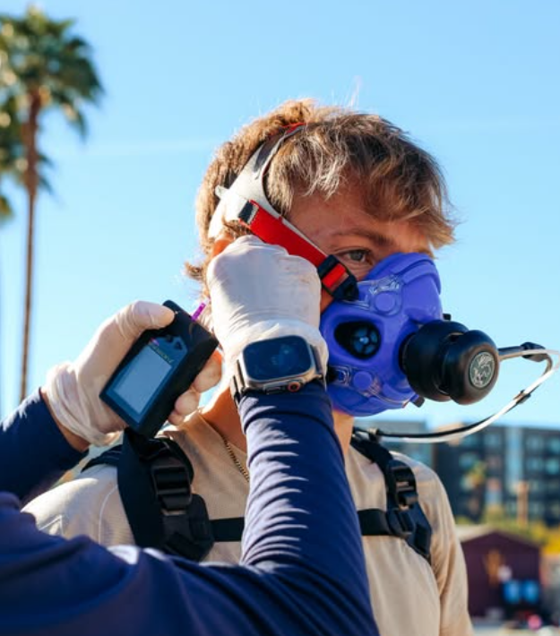
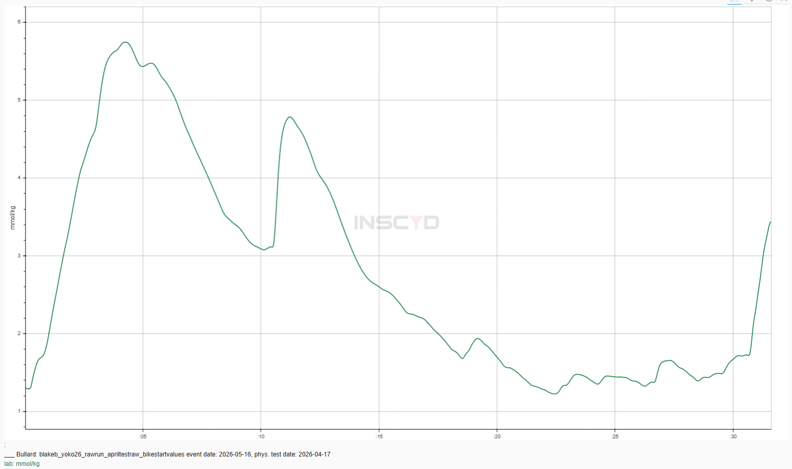
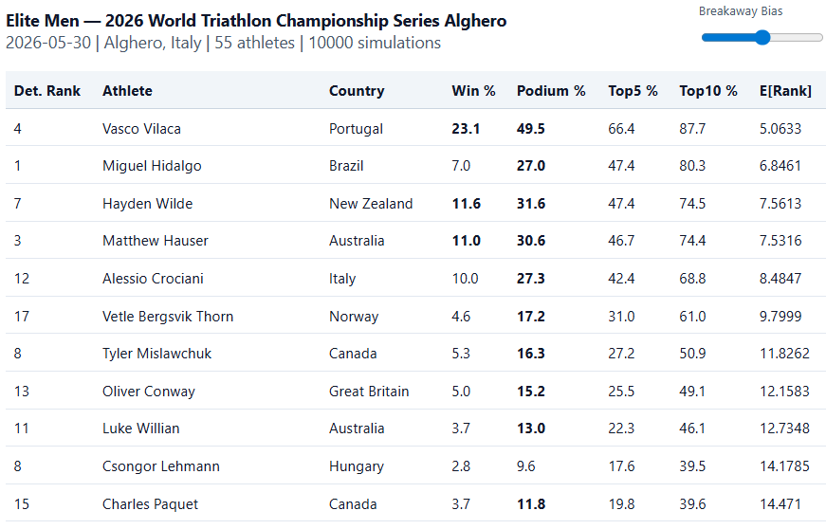

Data Analysis Overview
Parker Spencer has led Project Podium to the cutting edge of data science techniques within Triathlon. The combination of metabolic testing, race simulation, and modelling help provide athletes with specialized training programs and insights over the competition
Metabolic Testing
Race Analysis & Simulation
Future Race Modelling
INSCYD Partnership: Partnered with premier metabolic software provider INSCYD. Provides specialized reports for the athlete based on V02 max, VlaMax, and other key endurance markers.
Testing Procedure: Regular testing throughout the year ensures accurate training zones such that workouts are always tailored to the individual athlete’s needs rather than a broad group plan.
Historical Race Analysis: Data analysis on historical athlete performance to quantify improvement and compare current development athletes to Olympic Medalists past trajectory.
Individual Race Lactate Simulation: Using the metabolic profile of an athlete in combination with the athlete's race file allows us to simulate lactate levels during the race to identify tactical errors and training needs.
Race Briefings: Perform analysis on past performances for a given course to prepare athletes for the likely demands of competition and identify competitors well suited for the predicted race conditions
Race Simulation: Developing Monte Carlo Simulation based on decades of triathlon race history to help predict race results. Will help identify when an athlete is ready for the next level of competition.

Slide 6
Table of Contents
Pg. 3
Project Podium Overview
Pg. 7
Case Study

Slide 7
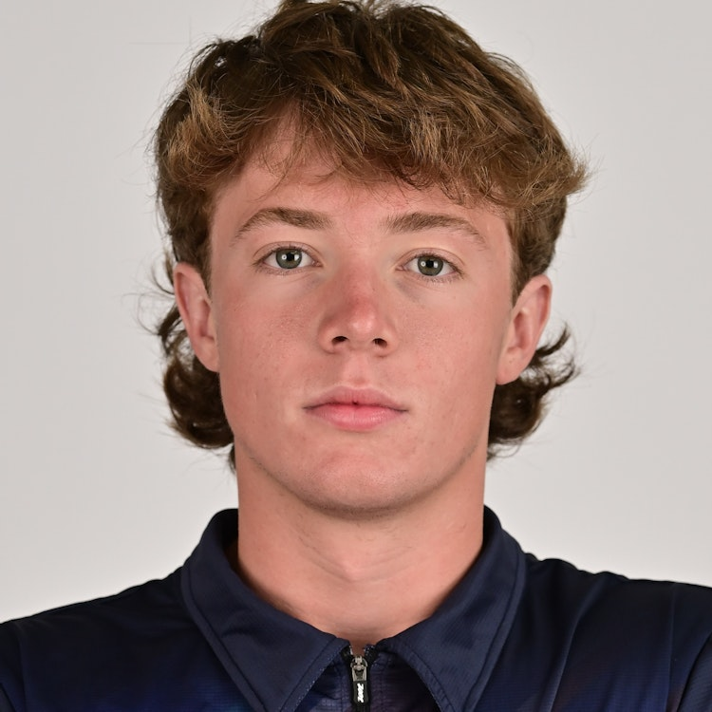
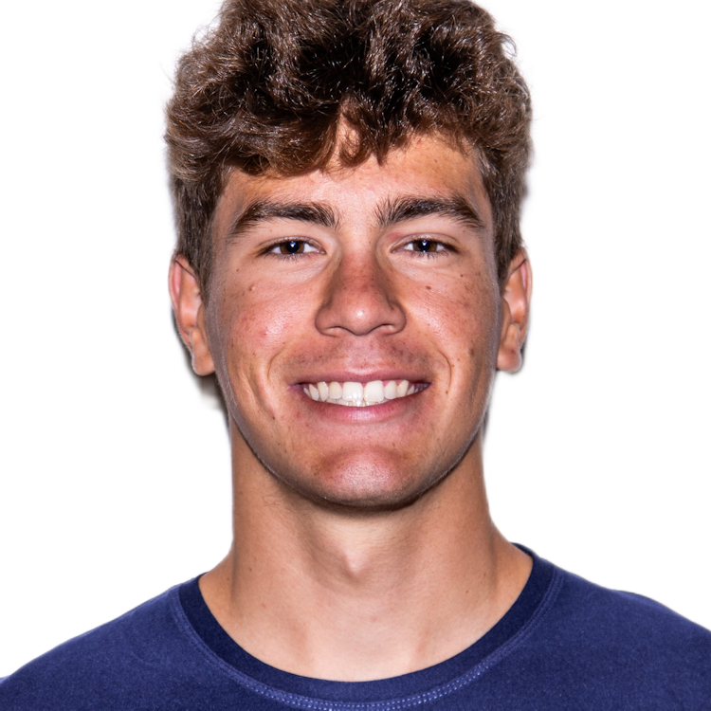
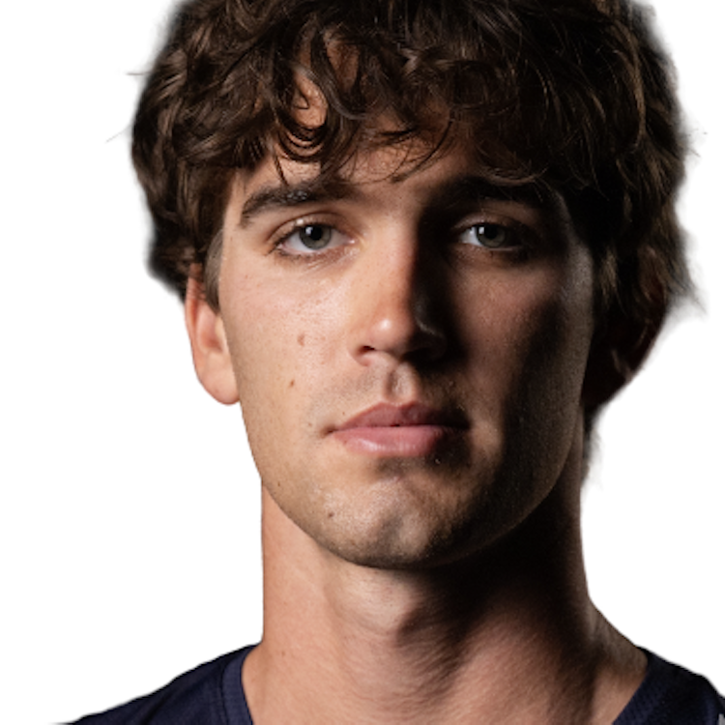
Individual Focus
Race Overview – WTCS Yokohama
WHO
Three Project Podium Athletes competed at the WTCS Yokohama – Braxton Legg, Blake Bullard, Reese Vannerson
WHAT
All three athletes came off the bike together in the main chase group. In this position, Reese was most likely to have the best performance
HOW
When analyzing the athletes bike data, Reese’s file in terms of average power looks very similar to Blake’s and Braxton’s.
WHY
This is important because without this data we might have believed Reese to have lost significant run fitness.
These athletes have similar metabolic profiles; however historically Reese Vannerson has been the top runner
Yet, he struggled on the run and finished 3rd among the group
However, using advanced simulation techniques we model out Reese’s Blood Lactate levels and see that he finished the bike far above his threshold. This led to poor run performance
Instead, it’s clear that Reese’s run was more so affected by the surges on the bike that spiked his lactate. With more bike handling preparation and awareness, we can help the athlete set himself up for their maximum potential on race day.
Notes:
shape
No alt text provided
pageNavigator
No alt text provided
Gap to Lead by Stage
No alt text provided
Name
No alt text provided
Place Change by Stage
No alt text provided
Place at Stage
No alt text provided
pivotTable
No alt text provided
slicer
No alt text provided
slicer
No alt text provided
shape
No alt text provided
Key Point
No alt text provided
Recent Performance
No alt text provided
image
No alt text provided

Slide 8
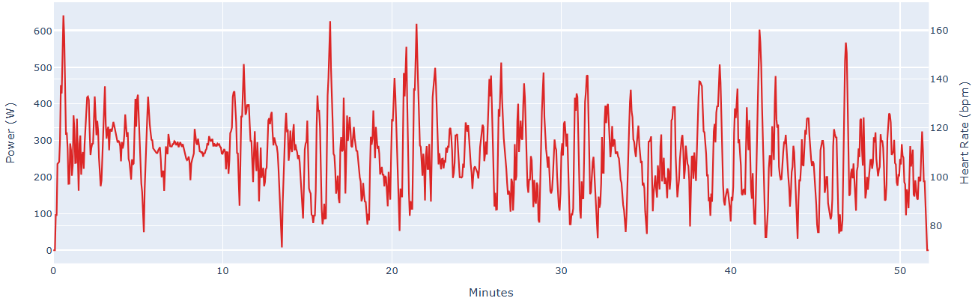
Individual Focus
Blake Bullard Yokohama Bike
Despite being in the breakaway, Blake minimized his surges over 600W once. Then when falling back into the main chase, Blake rode mostly around a medio effort keeping lactate below 4 mmol/kg
Raw Power File
Simulated Blood Lactate Concentration
Note: Power file shown with 2s smoothing for better visibility
Notes:
shape
No alt text provided
pageNavigator
No alt text provided
Gap to Lead by Stage
No alt text provided
Name
No alt text provided
Place Change by Stage
No alt text provided
Place at Stage
No alt text provided
pivotTable
No alt text provided
slicer
No alt text provided
slicer
No alt text provided
shape
No alt text provided
Key Point
No alt text provided
Recent Performance
No alt text provided
image
No alt text provided

Slide 9
Individual Focus
Blake Bullard Yokohama Bike
Blake began the bike in a small 7-man breakaway coming out of the water yet had his highest spikes in lactate once he had been dropped and settled into the main chase group. This suggests that Blake needs to continue working on bike skills rather than pure power numbers
Blake relatively even pacing resulted in a VI of 1.08, always keeping lactate below 4 mmol/kg and even dropped it all the way below 2 mmol/kg before starting the run
Simulated Blood Lactate Concentration
Bike Metrics
Average Power | 259 W
Average Power w/o 0’s | 290 W
Normalized Power | 279 W
Variability Index | 1.08
Ending LaB – 1.3
Notes:
shape
No alt text provided
pageNavigator
No alt text provided
Gap to Lead by Stage
No alt text provided
Name
No alt text provided
Place Change by Stage
No alt text provided
Place at Stage
No alt text provided
pivotTable
No alt text provided
slicer
No alt text provided
slicer
No alt text provided
shape
No alt text provided
Key Point
No alt text provided
Recent Performance
No alt text provided
image
No alt text provided

Slide 10
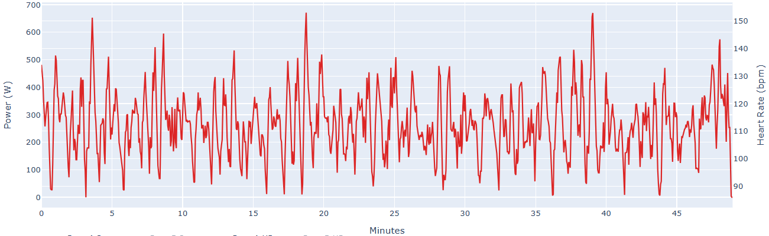
Individual Focus
Braxton Legg Yokohama Bike
As a taller athlete, Braxton is a bit heavier, but also has the highest threshold among the three. Despite an ability to hold higher power, Braxton minimized his surges over 600W to only 3 times during the ride. This kept his lactate below 4 mmol/kg for the whole effort.
Raw Power File
Simulated Blood Lactate Concentration
Note: Power file shown with 2s smoothing for better visibility
Notes:
shape
No alt text provided
pageNavigator
No alt text provided
Gap to Lead by Stage
No alt text provided
Name
No alt text provided
Place Change by Stage
No alt text provided
Place at Stage
No alt text provided
pivotTable
No alt text provided
slicer
No alt text provided
slicer
No alt text provided
shape
No alt text provided
Key Point
No alt text provided
Recent Performance
No alt text provided
image
No alt text provided

Slide 11
Individual Focus
Braxton Legg Yokohama Bike
Braxton also rode a mostly consistent effort with a VI of 1.09, keeping any surges to a minimum and riding a large portion of the ride near his maximum lactate clearance zone
He finished the ride with lactate concentration of 2.06 and went on for his best run performance to date
Simulated Blood Lactate Concentration
Bike Metrics
Average Power | 267 W
Average Power w/o 0’s | 307 W
Normalized Power | 289 W
Variability Index | 1.09
Ending LaB – 2.06
Notes:
shape
No alt text provided
pageNavigator
No alt text provided
Gap to Lead by Stage
No alt text provided
Name
No alt text provided
Place Change by Stage
No alt text provided
Place at Stage
No alt text provided
pivotTable
No alt text provided
slicer
No alt text provided
slicer
No alt text provided
shape
No alt text provided
Key Point
No alt text provided
Recent Performance
No alt text provided
image
No alt text provided

Slide 12
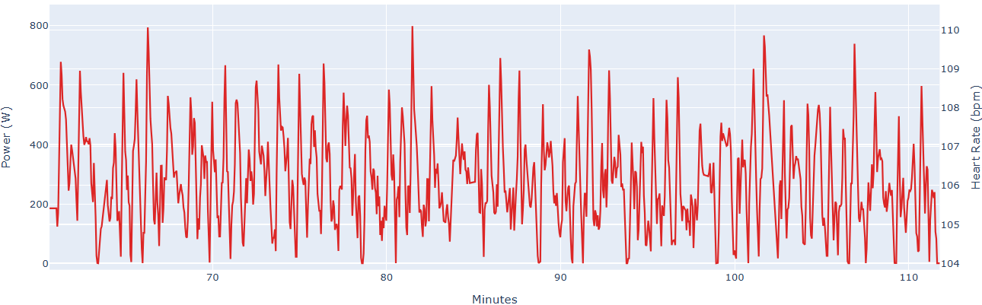
Individual Focus
Reese Vannerson Yokohama Bike
Reese spent significant time over 600 watts with several surges ~800 watts. This caused his lactate to rise significantly above threshold. Additionally, his bike positioning kept him from being able to ride his maximum lactate clearance wattage, keeping lactate high
Raw Power File
Simulated Blood Lactate Concentration
Note: Power file shown with 2s smoothing for better visibility
Notes:
shape
No alt text provided
pageNavigator
No alt text provided
Gap to Lead by Stage
No alt text provided
Name
No alt text provided
Place Change by Stage
No alt text provided
Place at Stage
No alt text provided
pivotTable
No alt text provided
slicer
No alt text provided
slicer
No alt text provided
shape
No alt text provided
Key Point
No alt text provided
Recent Performance
No alt text provided
image
No alt text provided

Slide 13
Individual Focus
Reese Vannerson Yokohama Bike
Despite a similar average power as Blake and Braxton, Reese had a higher Variability Index of 1.14 demonstrating the surges within his ride
With an ending blood lactate value of 8.21, Reese was significantly over threshold beginning the run
Simulated Blood Lactate Concentration
Bike Metrics
Average Power | 274 W
Average Power w/o 0’s | 314 W
Normalized Power | 312 W
Variability Index | 1.14
Ending LaB – 8.21
Notes:
shape
No alt text provided
pageNavigator
No alt text provided
Gap to Lead by Stage
No alt text provided
Name
No alt text provided
Place Change by Stage
No alt text provided
Place at Stage
No alt text provided
pivotTable
No alt text provided
slicer
No alt text provided
slicer
No alt text provided
shape
No alt text provided
Key Point
No alt text provided
Recent Performance
No alt text provided
image
No alt text provided

Slide 14
Individual Focus
Blake Bullard Yokohama Run
Using Blake’s Garmin watch we can simulate Blood Lactate using velocity as a proxy for the demands of the effort.
Potential limitations of velocity may include lack of air resistance, elevation, and other environmental factors in the race that effect run speed but not necessarily power (effort).
Simulated Blood Lactate Concentration
Run Metrics
Time | 32:12
Distance | 6.37
Average Pace | 4:57
NGP | 4:58
Ending LaB – 3.4
Notes:
shape
No alt text provided
pageNavigator
No alt text provided
Gap to Lead by Stage
No alt text provided
Name
No alt text provided
Place Change by Stage
No alt text provided
Place at Stage
No alt text provided
pivotTable
No alt text provided
slicer
No alt text provided
slicer
No alt text provided
shape
No alt text provided
Key Point
No alt text provided
Recent Performance
No alt text provided
image
No alt text provided

